Slide 1
Lecture 7
Stochastic processes: Exit times
Long-term behavior
Statistical computing: The Monte-Carlo EM - algorithm

Slide 2
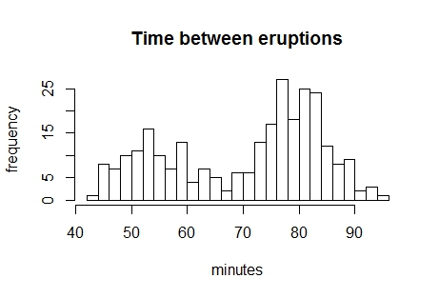
The EM algorithm for a mixture normal distribution (mixtools example)
library(mixtools)
data(faithful)
attach(faithful)
hist(waiting, breaks=25,main="Time between eruptions",
xlab="minutes", ylab="frequency")

Slide 3
#estimate the initial values
yy<-waiting[which(waiting >= 70)]
sd(yy)
[1] 5.456667
waits <- normalmixEM(waiting, w = .5, mu = c(53, 82), sigma = 5.5)
summary(waits)
summary of normalmixEM object:
comp 1 comp 2
lambda 0.36085 0.63915
mu 54.61363 80.09031
sigma 5.86909 5.86909
loglik at estimate: -1034.002

Slide 4
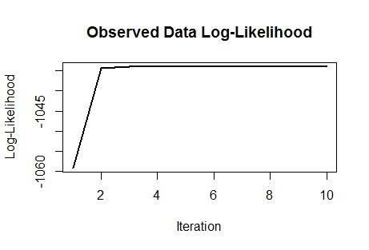
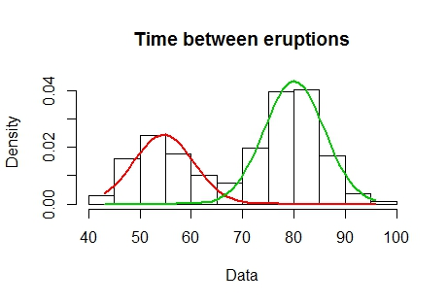
plot(waits, density=TRUE,
main2="Time between eruptions")

Slide 5
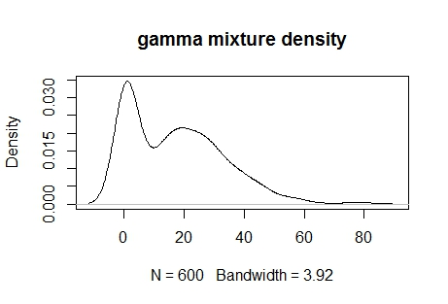
Gamma mixture example (3 components)
x <- c(rgamma(200, shape = 0.5, scale = 2), rgamma(200, shape = 3, scale = 8), rgamma(200, shape = 5, scale = 6))
plot(density(x),main="gamma mixture density")

Slide 6
out <- gammamixEM(x, lambda = c(1, 1, 1)/3, verb = TRUE)
out
$lambda
[1] 0.3464997 0.3010977 0.3524026
$gamma.pars
comp.1 comp.2 comp.3
alpha 0.4424004 4.142742 4.539635
beta 2.4383479 5.565782 6.215735
plot(out)

Slide 7
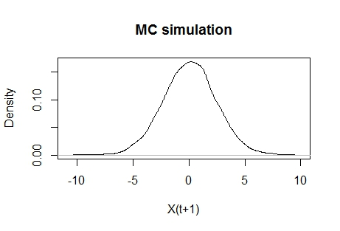

Simulating a MC Textbook Exercise 6.1 $X_{(t+1)}=ρX_{(t)}+ε_{(t)}$
mc1<-matrix(0,10000,2)
mc1[,1]<-rnorm(10000)
mc1[1,2]<-rnorm(1)
for(i in 2:10000)
{mc1[i,2]<-(0.9*mc1[i-1,2])
+mc1[i,1]}
plot(density(mc1[,2]),main='MC simulation',xlab="X(t+1)")

Slide 8

$$X_{(t+1)}=ρX_{(t)}+ε_{(t)}$$
var(mc1[,2])
#[1] 5.649379
1/(1-(0.9^2))
#[1] 5.263158
mean(mc1[,2])
#[1] 0.08016311

Slide 9
Readings
https://cran.r-project.org/web/packages/mixtools/vignettes/mixtools.pdf
Chib, Siddhartha, and Edward Greenberg. "Understanding the Metropolis-Hastings Algorithm." The American Statistician 49, no. 4 (1995): 327-35.

